Slide 1
Title of the Clinical Case
dr [Name] [Surname]
[Speciality]
[Country]

Slide 3
NEAUVIA SPEAKER
Professional Summary:
Brief description of the doctor’s experience, areas of expertise, certifications, and involvement with Neauvia.
[Name]
[Specialty]
[Country]
[@Instagram account]
Business Portrait

Slide 4
INTRODUCTION & CASE OVERVIEW
Provide a brief context about the condition treated and the reason for selecting a Neauvia product combination (fillers, devices, cosmeceuticals). Then, summarize the type of patient, treatment goal, main products used, and overall outcome.
E.g. “Periorbital sagging and volume loss are common concerns with aging. This case involves a 47-year-old female patient treated for midface volume loss using a PEG-HA filler and Zaffiro skin tightening. The combined approach aimed at lifting and hydration, showing visible improvement after two sessions.”

Slide 5
CASE REPORT
Patient(s) Description:
Products Used:
Technique / Parameters:
Key characteristics of the patient:
Age, gender, skin type (e.g., Fitzpatrick)
Aesthetic indications or complaints
Relevant medical or treatment history
E.g. “Healthy 47-year-old woman with the indication of the moderate loss of the temple hollow, in March 2016 patient has been diagnosed on hyperthyroidism…”
List each product with:
Full commercial name
Product type (filler, device, cosmeceutical)
Concentration, crosslinking type (if filler)
Indication
E.g. “Neauvia Intense Flux (Matex Lab, Switzerland), PEG-HA filler 26 mg/ml, used for deep volumization in midface.”
Describe how the treatment was performed:
Injection technique (e.g., fanning, bolus, sandwich)
Volumes used per area
Device settings: energy (mJ), pulse spacing, number of passes
Number of sessions and interval between them
E.g. “ Sandwich technique - infiltration of the temporal bone with 0.25 left side, 0.3 ml on the right side with Neauvia Intense LV, then Neauvia Intense Flux between layer 1-3 (superficial)…”

Slide 6
RESULTS
Include Before & After pictures with consistent:
Lighting, angle, and facial expression
Label the images (e.g., “Before”, “After 1 session”, “After 30 days”)
Indicate follow-up timeline and improvements observed
Additional data (optional):
Patient-reported outcomes (satisfaction, scales like GAIS or Lip Fullness Scale)
Histological or graphical data if available (e.g., fibroblast or collagen presence)
Use references if citing scientific results

Slide 7
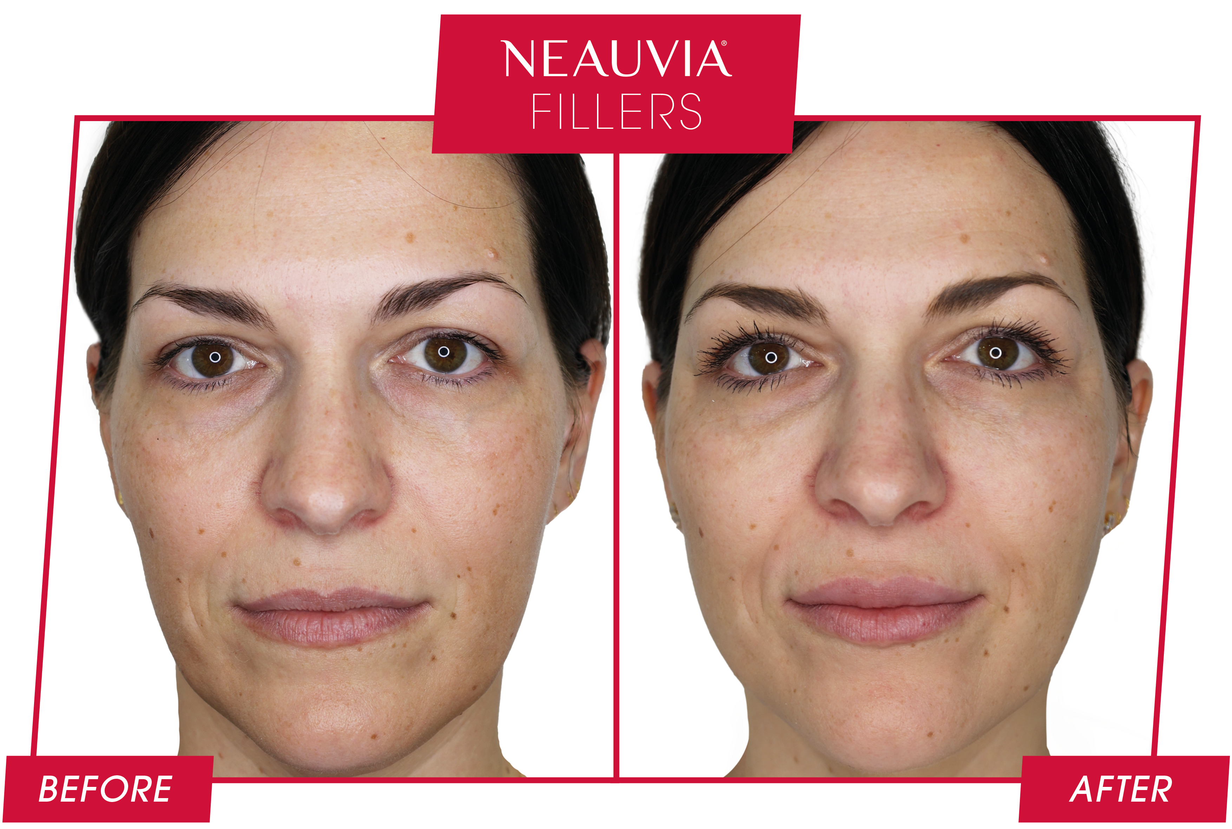
RESULTS PATIENT N. 1
Example - For illustrative purpose
TREATMENT DETAILS
AFTER 2 SESSIONS:
Session 1: Neauvia Intense 4ml Supraperiostum, Neauvia Stimulate 1ml Deep Dermis
Session 2: Neauvia Intense Lips 1ml Superficial, Neauvia Hydro Deluxe 2.5ml Dermis
Technique: Bolus and Fan Technique
Images courtesy of Dr Marko Mance, Plastic and Aesthetic Surgeon, Croatia.

Slide 8
RESULTS PATIENT N. 1
Example - For illustrative purpose
TREATMENT DETAILS
AFTER 2 SESSIONS:
Session 1:
LaserMe - 35 mJ/pulse – 1,8 mm spacing
Session 2:
LaserMe - 37 mJ/pulse – 1,8 mm spacing
The results depicted in these pictures are obtained by certain settings of the device which were tailor-made for particular patient. Note that parameters may/must be adjusted per each individual patient as each patient may react differently to the treatment based on (but not limited to) medical history, genetics, age, sex, personal motivation, lifestyle, and other factors, and are in no way guaranteed. The product(s) may only be used under supervision of a physician or health care provider in accordance to applicable laws and regulations. Neauvia does not encourage or endorse in any way the use of products not approved by applicable regulations : always refer to the approved Indication For Use.(IFU).
Notes:
PATIENT CODE: 01.02.2022_RD.10.74_LASME_WAW -> TRAINING
FILE NAME: 01.02.2022_RD.10.74_LASME_WAW_B&A_2T_RIGHT SIDE

Slide 9
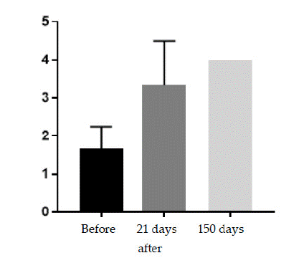
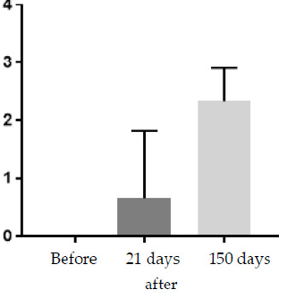
RESULTS ADDITIONAL DATA
Example - For illustrative purpose
Description:
The histological results at 21 days and 150 days post treatment showed an increase in the number of fibroblasts (tissue regeneration).
The presence of fibroblasts in the tissue is evidence of the ongoing process of producing new collagen fibers (graph 1,2).
Graph 1:
The presence of fibroblasts (Vimentin)
Graph 2:
The presence of collagen (Trichrom Masson)
Reference: Kubik, P.; Jankau, J.; Rauso, R.; Galadari, H.; Protasoni, M.; Gruszczynski,W.; Grzanka, D.; Smolinska, M.; Antosik, P.; Piesiaków, M.-L.; et al. HA PEGylated Filler in Association with an Infrared Energy Device for the Treatment of Facial Skin Aging: 150 Day Follow-Up Data Report. Pharmaceuticals 2022, 15, 1355. https://doi.org/10.3390/ph15111355

Slide 10
CONCLUSION
Summarize the outcome and key takeaways:
Was the combination effective and safe?
What were the main improvements?
Would you recommend this protocol?
Example:
In the presented case, the combination of hyaluronic acid cross-linked with polyethylene glycol (PEG) and infrared gave satisfactory results due to its high tolerability and effectiveness.
In addition, the therapy induced a visible change in elasticity, hydration, and firming of sagging skin.
Collaborative efforts among specialists, after thorough consultations, together with increased utilisation of technological devices and individual commitment to personal discipline via the use of cosmeceuticals, might yield very favourable outcomes by avoiding the need for more invasive procedures, such as surgical interventions.

